Slide 1
Jenkins

Slide 2
Overview of Jenkins

Slide 3


Agenda
What is Jenkins?
Benefits of Jenkins
Demo
Configure Global Security
Configure System
Managing Plug-ins
Creating Items/Jobs
Creating Pipeline
Plugins
Links / References

Slide 4
What is Jenkins?
Jenkins is a open source Continuous Integration tool which is use for Building, Testing and Deploying your projects.
Jenkins is written in Java.
Jenkins is a cross-platform which can run on Windows, Linux, and Mac Operating Systems.
It is used to build and test your software projects continuously making it easier for developers to integrate changes to the project, and making it easier for users to obtain a fresh build.
It also allows you to continuously deliver your software by providing powerful ways to define your build pipelines and integrating with a large number of testing and deployment technologies.

Slide 5
Benefits of Jenkins
It automates the build and keep it fast.
It supports the common SCM tools such as CVS, Subversion, Git and Clearcase
It can also execute Apache Ant and Maven based projects as well as running shell scripts and windows batch commands.
Integration, Merging, choosing packaging, and building are all done automatically with Jenkins.
Jenkins also monitors the execution of the steps and allows to stop the process if one of the build fails.
Jenkins organized and put everything together, and keep it accessible to your team through the web.

Slide 6
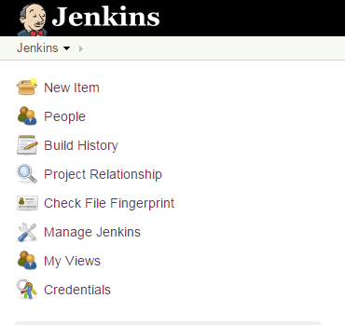
Dashboard – Menu
New Item
People
Build History
Project Relationship
Check file Fingerprint
Manage Jenkins
My Views
Credentials

Slide 7



Items/Jobs Status
S – Status of the last build
- Successful
- Failed
W – Weather report shows the aggregated status of the recent build.
Name – Name of the Project/Item/Job
Last Success – Last successful run of the job.
Last Failure – Last failure run of the job.
Last Duration – Shows the duration of the last job you ran.

Slide 8
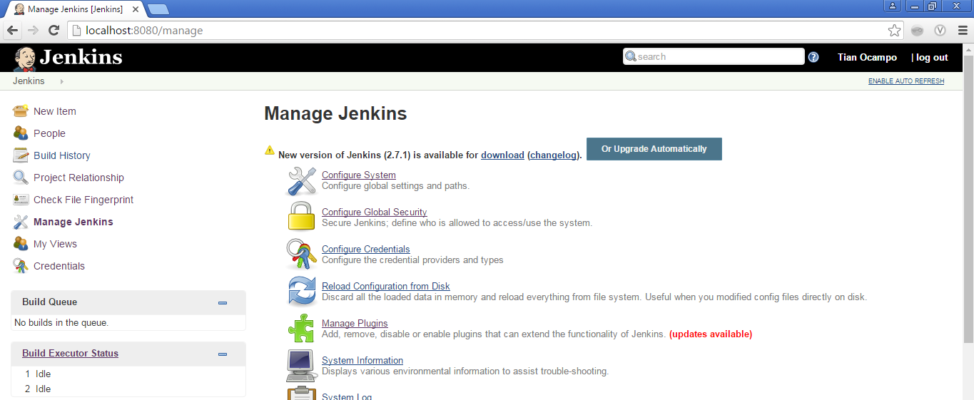
Setting Up Jenkins
Click Manage Jenkins on the dashboard and click Configure System

Slide 9
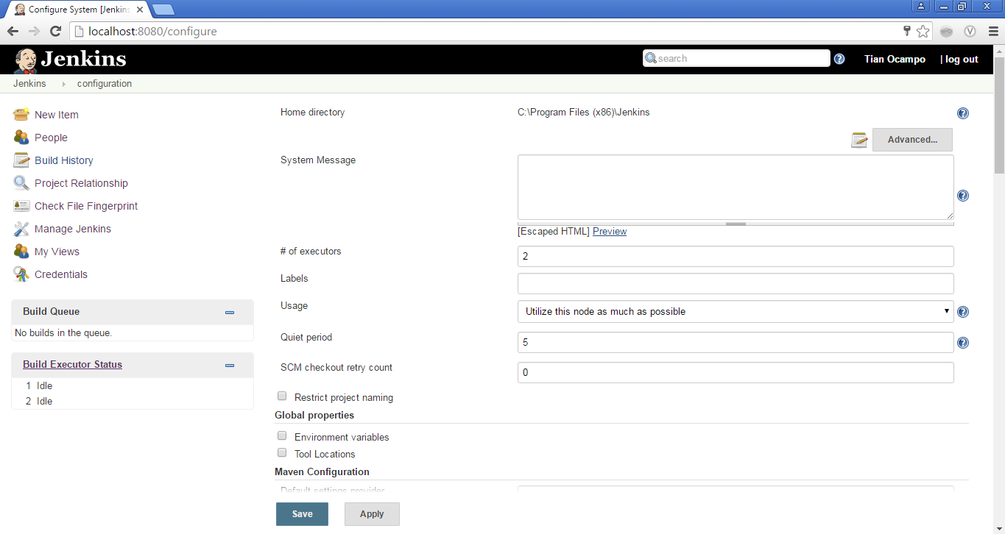
Configure System
Click Manage Jenkins on the dashboard and click Configure System

Slide 10
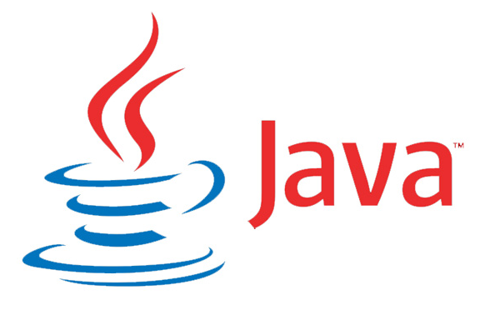

Configure System
JDK Installation
Indicate Name and location of installation
Example: JDK 7 and C:\Program Files (x86)\Java\jdk1.7.0_55
Maven Installation
Indicate Name and location of installation
Example: Maven Standard and C:\Program Files (x86)\apache-maven-3.3.9

Slide 11
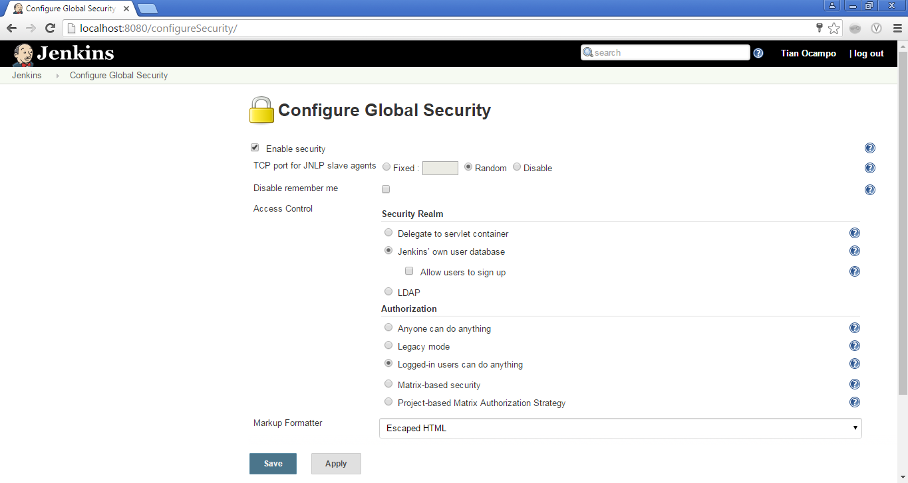
Configure Global Security
Click Manage Jenkins on the dashboard and click Configure Global Security

Slide 12
Configure Global Security
Enable Security
Authentication
LDAP
Jenkins’ own database
Delegate to servlet container
Authorization
Field | Description
Anyone Can Do Anything | Full Access
Legacy Mode | Admin users to have full access, others can have only read-only access
Logged-in Users Can Do Anything | Full access for logged in users
Matrix-based Security | Filter resource access for each user
Project-based Matrix Authorization Strategy | Similar to Matrix-based security, but can be set at project level. Recommended if you have multiple projects running on the same CI server and want to restrict access to individual project teams.

Slide 13
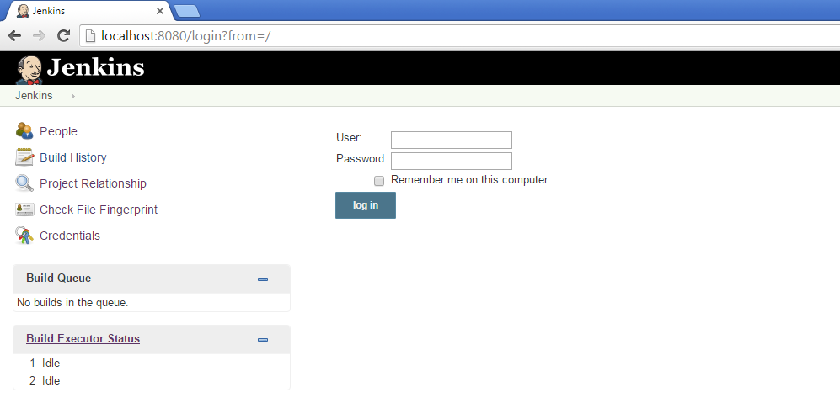
Jenkins login window
The login page of Jenkins

Slide 14
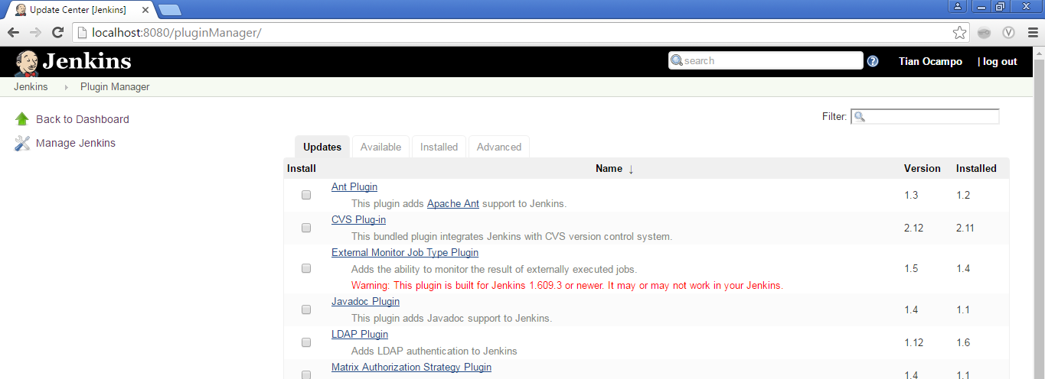
Managing Plug-Ins in Jenkins
Click Manage Jenkins on the dashboard and click Manage Plugin

Slide 15
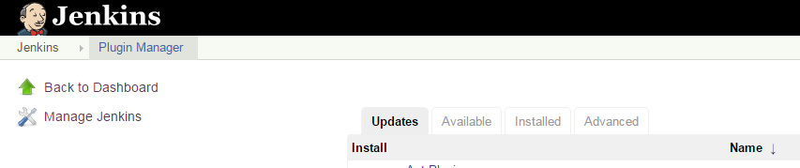
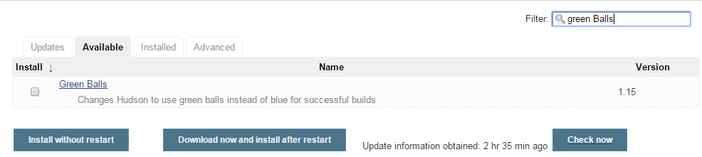
Installing Plug-Ins
Click “Available” Tab
On the “Filter”, type the plugin name that you want to install. (Example. Green Balls).

Slide 16
Managing Plug-Ins in Jenkins
Click Manage Jenkins on the dashboard and click Manage Plugin

Slide 17
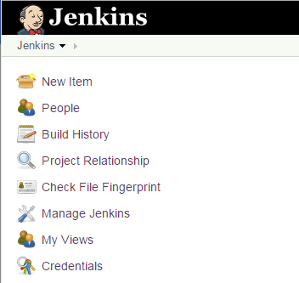
Creating a New Item/Job
Click New Item on the dashboard.

Slide 18
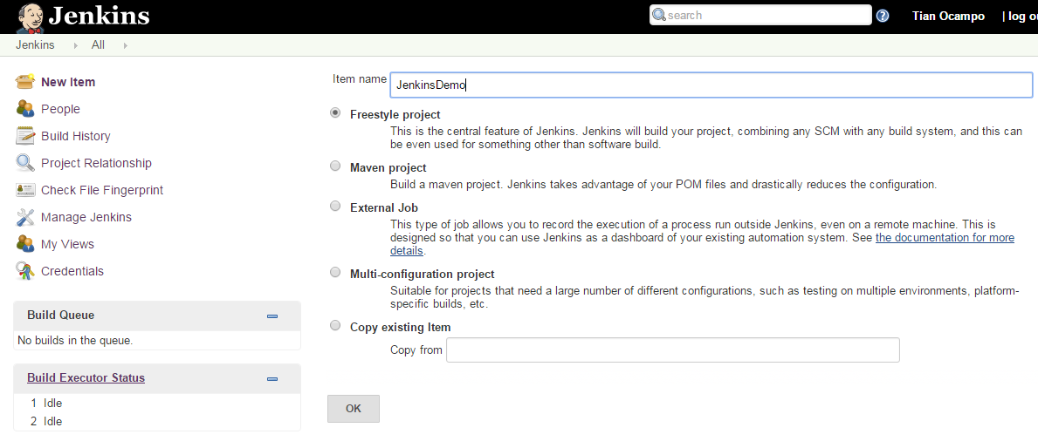
Configuring the New Item/Job

Slide 19
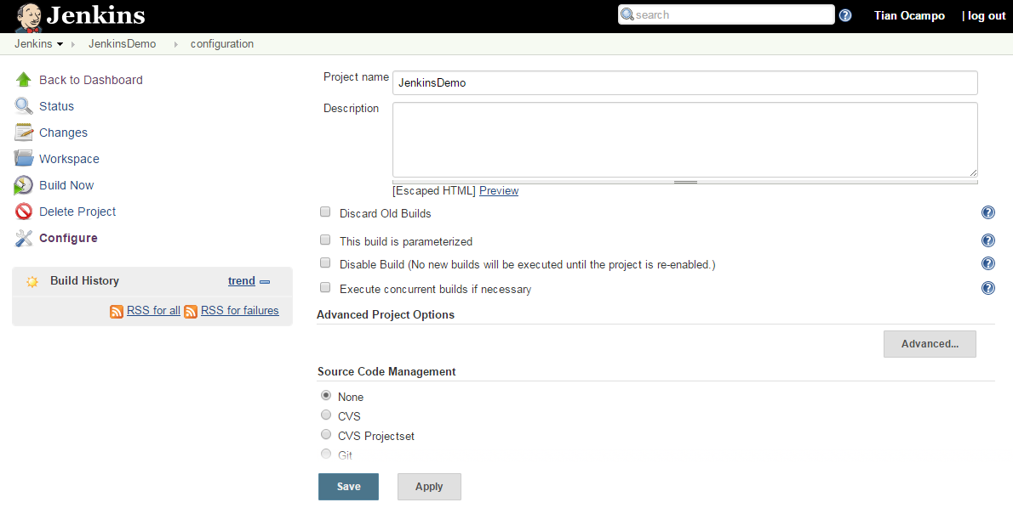
Configuring the New Item/Job

Slide 20
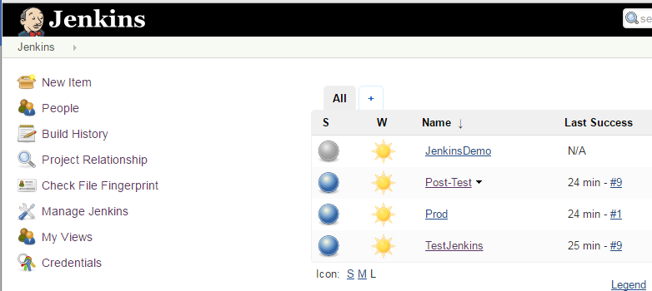
Creating a Pipeline for Items/Jobs
To create a Pipeline, click the “+” icon on the Jenkins menu.

Slide 21
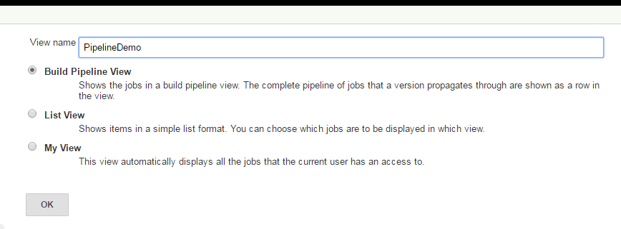
Creating a Pipeline for Items/Jobs
Enter the Pipeline name. (Ex. “PipelineDemo”)

Slide 22
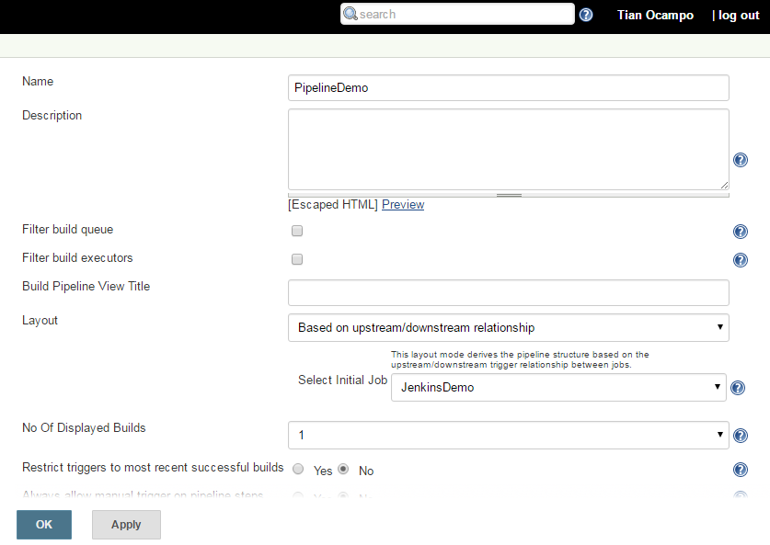
Creating a Pipeline for Items/Jobs

Slide 23
Plug-ins
Jenkins provides over 400 plugins to support.
Source code management
Build triggers
Build tools
Build wrappers
Build notifiers
Slave launchers and controllers
Build reports
Artifact uploaders
Other post-build actions
External site/tool integrations
You may view the complete list of the plugins by visiting the link provided in the Links and Preferences.

Slide 24
Links and References
Jenkins Installer
https://jenkins.io/
War Release files:
http://mirrors.jenkins-ci.org/war-stable/
Zip Release files:
http://mirrors.jenkins-ci.org/windows-stable/
Jenkins Tutorial
http://www.tutorialspoint.com/jenkins/jenkins_setup_build_jobs.htm
Jenkins List of Plugins
https://wiki.jenkins-ci.org/display/JENKINS/Plugins
Jenkins Terminilogy
https://wiki.jenkins-ci.org/display/JENKINS/Terminology

Slide 25

Question and Answer:

